Slide 1



URL Shortener Webservice
DevOps Implementation & Automation Project
Team Members :
Omar Mohsen
Marwa Elzoghby
Marwan Ayman
Sara Darwish
Ahmed Anas
Under Supervision of Digital Egypt Pioneers Initiative & Eng. Ahmed Gamil

Slide 2
Acknowledgments
Instructor's Guidance
We extend our deepest gratitude to our esteemed instructor Eng. Ahmed Gamil for their invaluable guidance, unwavering support, and insightful mentorship throughout the duration of this project and this entire initiative. Their expertise and encouragement were instrumental in our learning and successful completion.
Program Initiative
This project was made possible through the comprehensive framework and resources provided by the Digital Egyptian Pioneers Initiative(Depi). We are thankful for the opportunity to participate and contribute to this impactful initiative.

Slide 3

Project Overview
The Challenge
Building a production-ready URL Shortener webservice as a containerized microservice with comprehensive observability, automation, and deployment pipelines.
Our Approach
We followed a structured, 4-week implementation plan with key phases:
Build
Initial development phase.
Metrics
Tracking performance and data points.
Visualization
Displaying Metrics through dashboards.
Alerting & Persistence
Notifications and data storage systems.

Slide 4

Technology Stack
Core Stack
Backend & Data
Containerization
Observability
Alerting & Persistence
FastAPI for high-performance REST API with automatic documentation
Docker for consistent deployment environments
Prometheus for metrics collection and monitoring
Grafana Alerts with automated thresholds
Docker Compose for orchestrating multi-container applications
Grafana for visualization and real-time dashboards
Docker Volume adding Persistence for (SQLite, Prometheus, Grafana)
SQLite for lightweight, persistent data storage
Additional Features
Contact-Point & Provisioning
CI/CD Pipeline
Frontend
Discord Webhooks for instant notifications
CI Pipeline: for Sanity Check on develop Branch pushes
HTML/CSS/JS for intuitive user interface
Automated Provisioning for predefined Prometheus metric, Grafana Dashboards, Alerts, and Contact-Points
Deployment
CD Pipeline Deploy/Check Health on AWS on merging to Main branch
AWS EC2 for scalable cloud hosting
Kubernetes orchestrate containers as POC

Slide 5











System Architecture
FrontEnd
FastAPI
Prometheus
Grafana
Collecting Metrics
Generate Dashboards
Server
Container 2
SQLite
Container 1
Container 3
Data Base
CI Pipeline on Pushing Develop
CD Pipeline on Merging Main
Performs Sanity Testing
Deploy on Cloud

Slide 6







Core Project Features
Our URL Shortener Webservice is built with a strong foundation, focusing on performance, reliability, and observability.
REST API
SQLite Persistence
Containerized Deployment
Seamlessly shorten and redirect URLs with a robust and well-documented RESTful interface.
Ensures reliable and lightweight data storage, maintaining all shortened URL records.
Utilizes Docker and Docker Compose for consistent, portable, and scalable application environments.
Prometheus Metrics
Grafana Dashboards
Grafana Alerts
Exposes comprehensive application metrics on the /metrics endpoint for detailed monitoring.
Visualizes key performance indicators like URL creation rate, redirects, latency, and 404 errors.
Proactive notifications for critical thresholds and deviations from normal operating parameters.
Persistent Volumes
Guarantees data resilience and durability for all stored application data, preventing loss.

Slide 7
Beyond Core
Our Enhanced Contributions
We significantly expanded the base project with production-ready features, automation, and user experience improvements.
Frontend User Interface
1
User Interface: Built an intuitive web app for URL creation and redirection using HTML / CSS / JS
Automated Monitoring
2
Automated Dashboards: Pre-provisioned Grafana dashboards for instant visibility into key metrics.
Alerting System: Real-time Discord alerts for errors, latency, and downtime.
CI/CD Automation on cloud
3
CI Pipeline: GitHub Actions automate linting, testing, and validation on commits.
CD Pipeline: Dockerized deployment to AWS EC2 with automated health checks and team notifications.
Kubernetes Proof of concept
4
Kubernetes-based local deployment to Validate core Kubernetes concepts locally before moving to EKS production.

Slide 8




CI/CD Pipeline Architecture
Continuous Integration
Continuous Deployment
Automated quality checks ensure code reliability before deployment.
Production deployment happens automatically with built-in safeguards.
Code Push
Merge Event
Developer commits to develop branch
Pull request merged to main branch
Build Stage
AWS Deployment
GitHub Actions builds Docker images
Docker containers deployed to EC2 instance
Sanity Checks
Health Checks
API endpoint validation, container health verification
GitHub Actions confirm service health
Review Ready
Monitoring Active
Green status enables merge to main
GitHub Actions indicates successful deployment

Slide 9
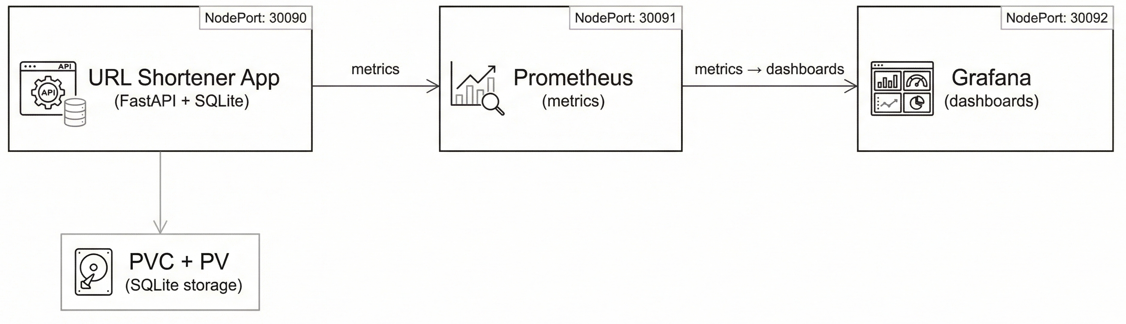
Kubernetes Implementation

Slide 10
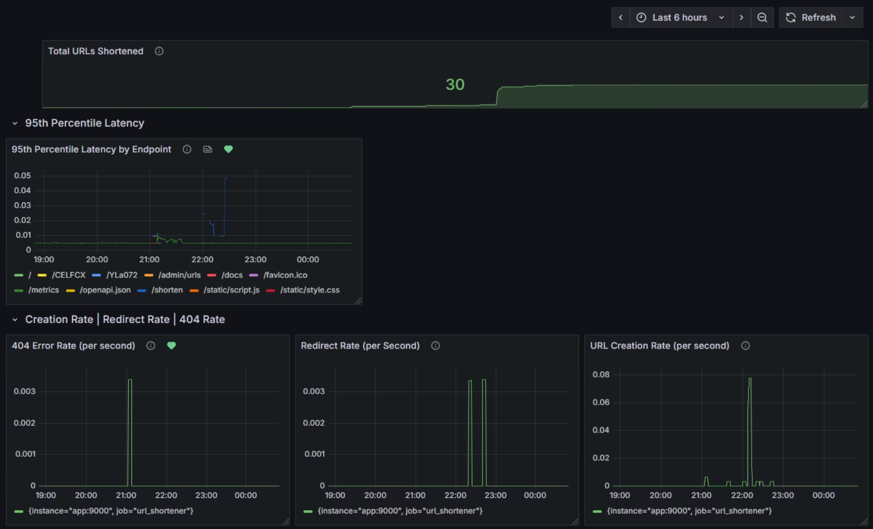
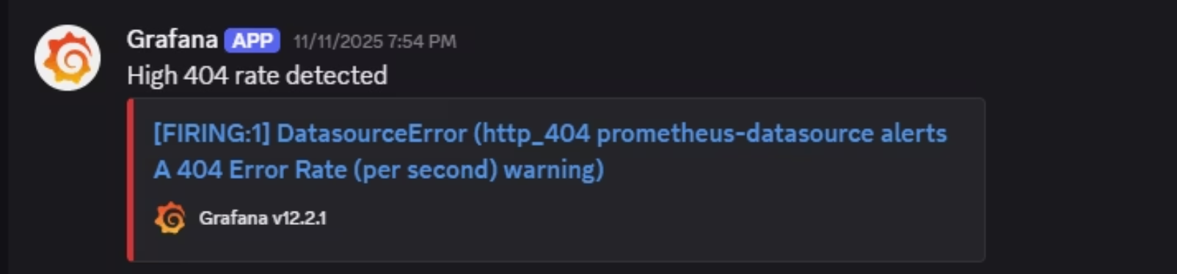
Monitoring & Alerts in Action
Discord Alert Example
Key Monitored Metrics
Creation Rate
404 Error Count
Response Latency
Redirect Rate

Slide 11
Future Roadmap
Scaling Beyond MVP
Security & Authentication
1
Implement JWT-based user authentication. Add API key management for programmatic access and apply per-user/API key rate limiting.
2
Database Migration
Migrate from SQLite (PostgreSQL) for scalability and reliability with zero-downtime transition.
Infrastructure Scaling
3
Use AWS Auto Scaling Groups with Application Load Balancer and enable horizontal pod autoscaling in Kubernetes.
4
EKS-Ready Production Deployment
Use EKS cluster with autoscaling, stateful workloads, and S3-backed StorageClass for massive-scale persistent storage
Team Contributions
[Omar Mohsen: Team Member 1] — Backend & API Development, Containerization, Provisioning Grafana, Prometheus
[Sara Darwish: Team Member 2] — Frontend & Alerting Integration
[Marwa Elzoghby: Team Member 3] — Monitoring & Visualization integration using Prometheus & Grafana
[Marwan Ayman: Team Member 4] — Data Base Schema Design, CI pipeline Sanity test
[Ahmed Anas: Team Member 5] —CD Pipeline & Cloud Deployment & Kubernetes implementation

Slide 12
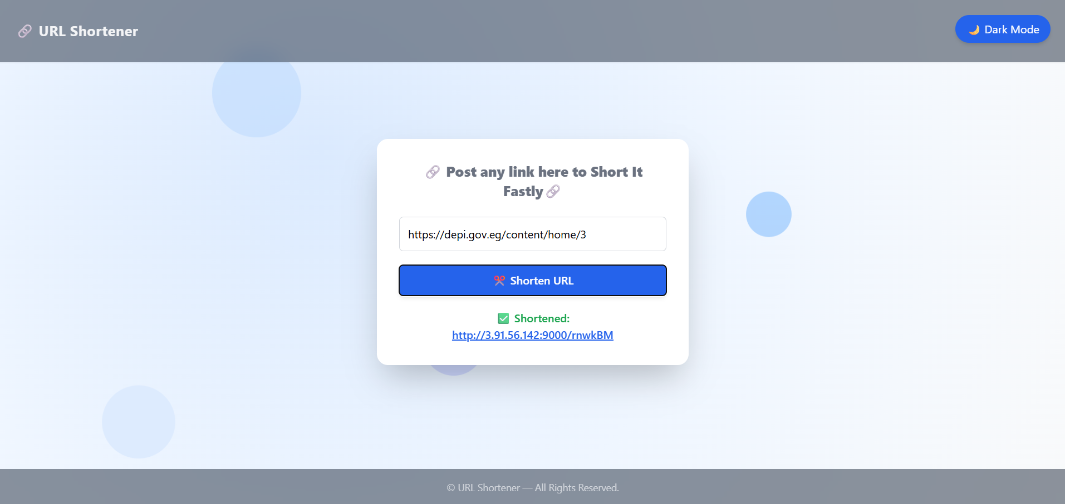
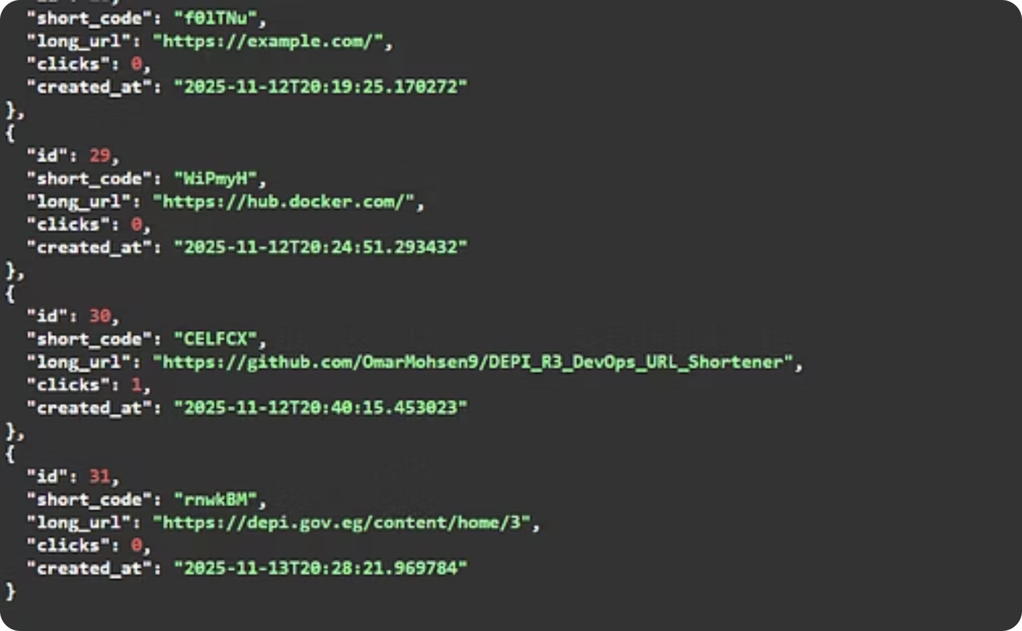
Demo
Explore the live demonstration of our system's core features, showcasing the user interface, monitoring dashboards, and automated processes.
Shorten URL
Database entry Created

Slide 13
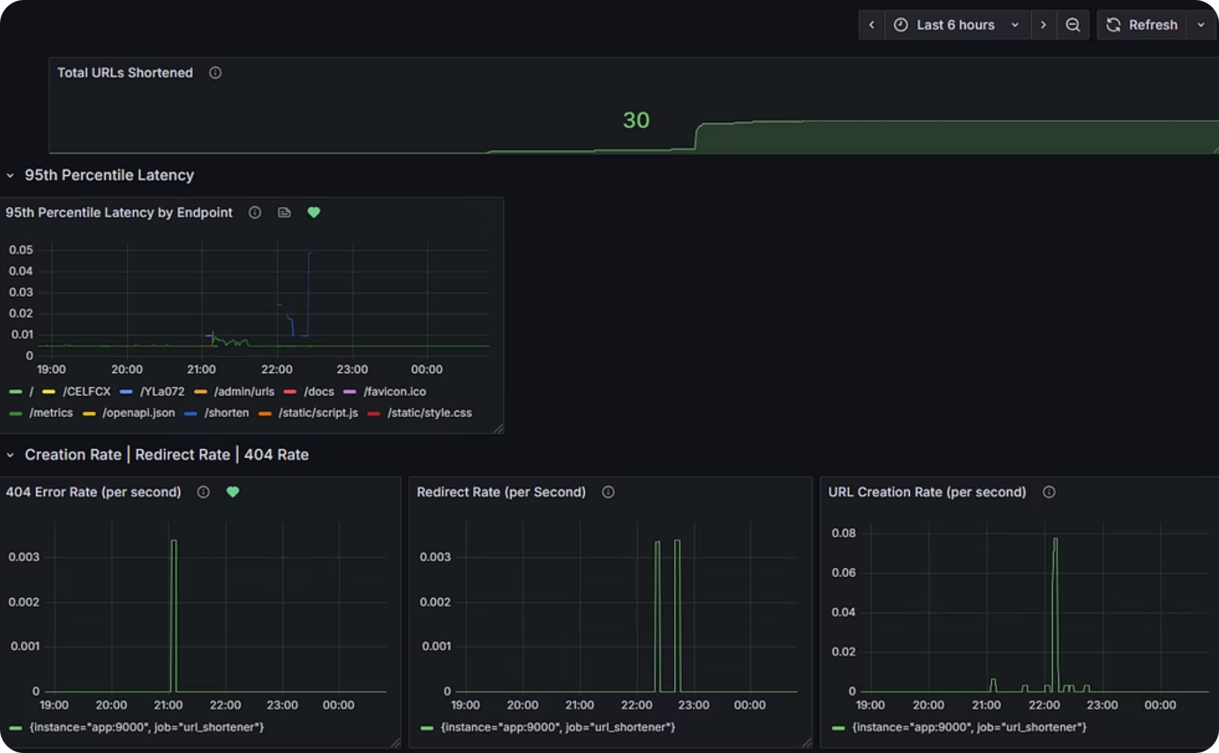
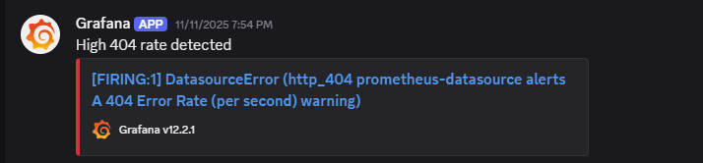
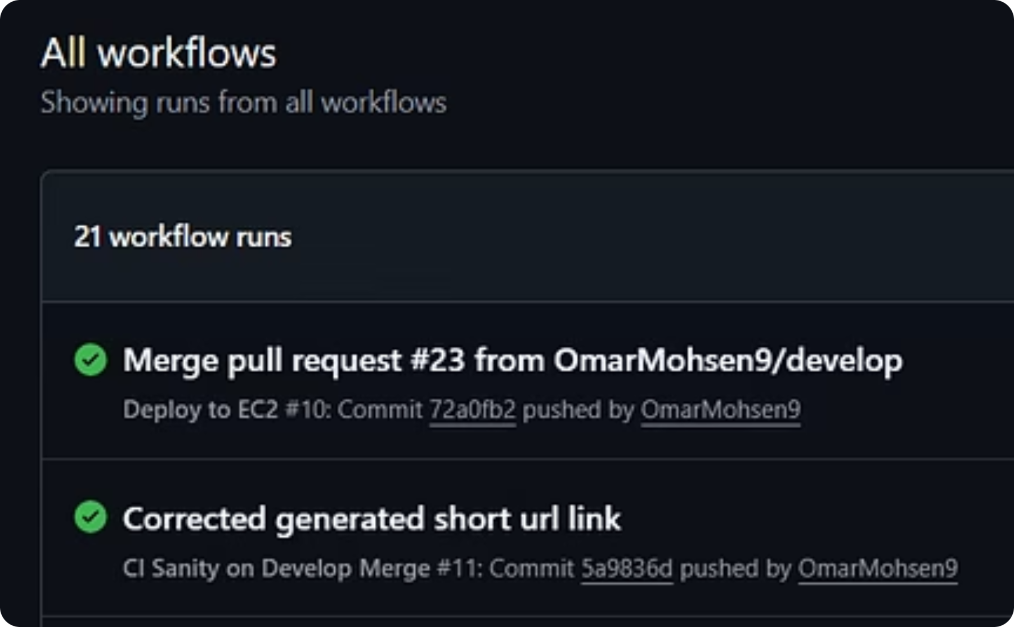
Demo
Grafana Dashboard
Discord Webhook Alert System
CI/CD Pipeline

Slide 14
Thank You

